Slide 1
Mini project on YouTube Video Downloader Using Python
By
Aditi Bhabire
Rutuja Bhagate
Shraddha Dayama

Slide 2
About Python
Python is a high-level, general-purpose and a very popular programming language. Python programming language (latest Python 3) is being used in web development, Machine Learning applications, along with all cutting edge technology in Software Industry.
Facts about Python Programming Language:
Python allows programming in Object-Oriented and Procedural paradigms.
Python programs generally are smaller than other programming languages like Java. Programmers have to type relatively less and indentation requirement of the language, makes them readable all the time.
Python language is being used by almost all tech-giant companies like – Google, Amazon, Facebook, Instagram, Dropbox, Uber… etc.

Slide 3
About YouTube Video Downloader
Aren’t there a lot of YouTube videos you wished you could’ve watched without the internet on your laptops or desktops?
Well, here’s your solution. In this project, we have created a YouTube video downloader where you can download the video straight from YouTube to your laptop in desired path given by user.
The Youtube Video Downloader is developed using Python Tkinter .
In this python project user has to copy the youtube video URL that they want to download and simply paste that URL in the ‘paste link here’ section and by clicking on browse button user can select which path/folder he wants to download the video ,after clicking on the download button, it will start downloading the video. When video downloading finishes, it shows a message ‘downloaded’ popup on the window below the download button.

Slide 4
Project Prerequisites
YouTube is a very popular video-sharing website. Downloading a video’s/playlist from YouTube is a tedious task. Downloading that video through Downloader or trying to download it from a random website increase’s the risk of licking your personal data. Using the Python Tkinter package, this task is very simple-efficient-safe. Few bunch codes will download the video for you. For this, there are two Python libraries – Tkinter and pytube.

Slide 5
Modules Required
If you are on Window’s
pip install pytube3
pytube :pytube is a lightweight, simple-to-use, dependency-free Python library that is used for downloading videos from the web.pytube, is not an auto-configured library. You need to install it before using it. Installation of pytube is easy when you have pip. In the Terminal or Command Prompt, type the following command to install pytube.
If you are on Window’s
pip install pytube3
2. Tkinter: Tkinter is a Python binding to the Tk GUI toolkit. It is the standard Python interface to the Tk GUI toolkit or in simple words Tkinter is used as a Python Graphical User interface. Tkinter is the native library, you don’t need to install it externally, just import, while you use it.

Slide 6
Project File Structure:
Here are the steps you will need to execute to build this Python YouTube Video Downloader Project: 1. Importing all the necessary imports 2. Creating the download and browse buttons functions 3. Initializing the window and placing all its components

Slide 7
Importing all the necessary modules:
import tkinter as tk
from tkinter import *
from pytube import YouTube
from tkinter import messagebox, filedialog

Slide 8
Code Explanation:
Import the packages.
Add URL of the youtube video that we want to download.
Calling youtube method.
In order to download the video from youtube, we need to define the stream resolution first.
To download the video from youtube we will use the download method
After downloading video message will pop out displaying successfully downloaded along with the path.

Slide 9
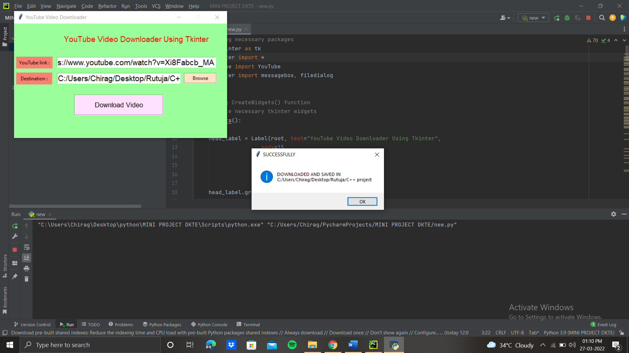
Output:

Slide 10
Advantages:
Source of E-learning service:
Download the preferred music from it
Make your own playlist
4. This is completely free
No viruses, spyware or malware
Support for almost any quality or format available from YouTube

Slide 11
Disadvantage:
It has no converter
Once you click on start download you cannot stop it in middle.
Downloading depends on users internet speed.

Slide 12
THANKYOU !!

